Slide 1

ARTIFICIAL
INTELLIGENCE
This presentation will introduce our Artificial Intelligence project,
highlighting its objectives, methodologies, and potential impact.
╰┈➤ Yash Mishra (202401100300285)
╰┈➤ Yogesh Bansal (202401100300288)
╰┈➤ Srashti Gupta (202401100300251)
╰┈➤ Vinay Rathore (202401100300280)
╰┈➤ Sudeeksha Singh (202401100300252)

Slide 2
CONTENT
OVERVIEW
PROBLEM
METHODOLOGY
DATA
DEVELOPMENT
RESULT
FUTURE
RefErences
01
02
03
04
05
06
07
08
00

Slide 3
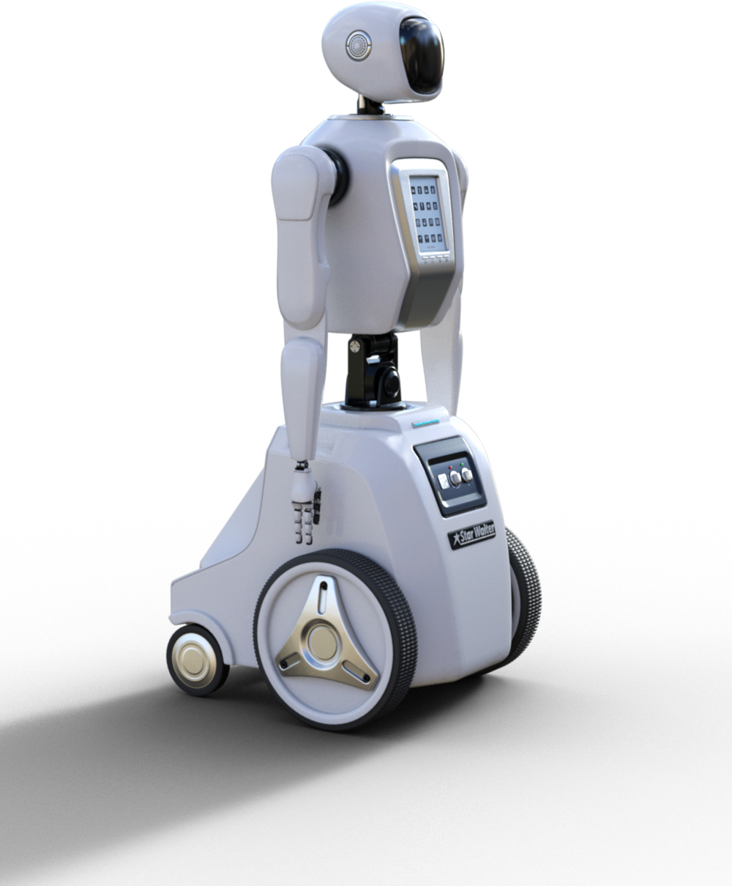
01
PROJECT OVERVIEW
Our Artificial Intelligence project aims to develop advanced algorithms and machine learning models to solve complex problems in various domains. By leveraging AI technologies, we seek to enhance efficiency, accuracy, and decision-making processes.

Slide 4

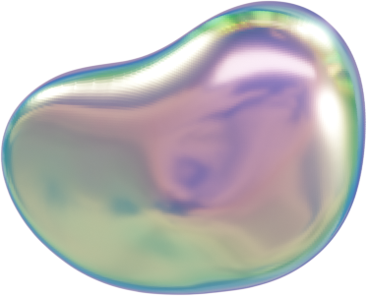
02
PROBLEM STATEMENT
Develop a classification model to detect heart disease based on medical parameters. Visualize data and model predictions.

Slide 5
03
METHODOLOGY
Dataset
Used UCI Heart Disease dataset containing medical attributes and diagnosis labels.
Preprocessing
Handled missing values and encoded categorical features.
Converted target to binary: 0 (No Disease), 1 (Disease).
EDA
Analyzed feature correlation and class distribution using plots and heatmaps.
Modelling
Applied Logistic Regression for binary classification.
Evaluation
Assessed performance using accuracy, confusion matrix, classification report, and ROC-AUC curve.
.

Slide 6

.
training.
.
04
DATA COLLECTION
AND PREPROCESSING
Data Source: UCI Heart Disease dataset (publicly available medical dataset).
Features: Includes age, sex, chest pain type, cholesterol, blood pressure, ECG results, etc.
Target Variable: Converted to binary: 0 – No Heart Disease, 1 – Heart Disease Present.
Preprocessing Steps:
Handled missing values using median/mode.
Encoded categorical variables numerically.
Removed irrelevant ID columns.
Scaled numerical features for model training.

Slide 7
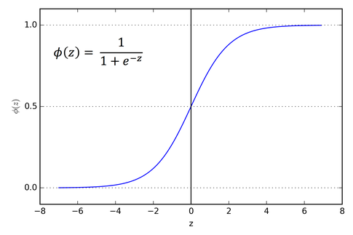
05
MODEL
DEVELOPMENT
Model Used: Logistic Regression — a simple yet effective classification algorithm.
Train-Test Split: Dataset split into 80% training and 20% testing for evaluation.
Training: Model was trained on scaled and preprocessed features.
Why Logistic Regression?
Interpretable results
Suitable for binary classification
Fast and efficient
Tools & Libraries: Python, Scikit-learn, Pandas, NumPy

Slide 8



06
RESULT AND IMPACT
Model Accuracy: Achieved ~85% accuracy on test data.
Key Metrics:
High Precision & Recall
Strong ROC-AUC Score
Impact:
Helps in early detection of heart disease
Assists doctors in making data-driven decisions
Can reduce diagnosis time and improve patient care

Slide 9

07
FUTURE DIRECTIONS
Try Advanced Models: Explore Random Forest, SVM, and XGBoost for better accuracy.
Hyperparameter Tuning: Use Grid Search or Randomized Search to optimize model performance.
Deploy as Web App: Build an interactive prediction tool using Streamlit or Flask.
Use Real-Time Data: Integrate live medical data for real-world testing and monitoring.
Expand Dataset: Include more patient records and features for improved generalization.

Slide 10
references
>Data Set : https://www.kaggle.com/datasets/redwankarimsony/heart-disease-data
>Model and Libraries
Pedregosa, F., et al. Scikit-learn: Machine Learning in Python, Journal of Machine Learning Research, 2011. https://scikit-learn.org
Hunter, J. D. Matplotlib: A 2D graphics environment, Computing in Science & Engineering, 2007. https://matplotlib.org
Waskom, M. L. Seaborn: statistical data visualization, Journal of Open Source Software, 2021. https://seaborn.pydata.org
McKinney, W. Data Structures for Statistical Computing in Python, 2010. https://pandas.pydata.org

Slide 11



